Slide 1
Data Lab: Manipulating Bits
Instructors:
Yunju Baek

Slide 2
Introduction
The purpose of this assignment is to become more familiar with bit-level representations of common patterns, integers, and floating-point numbers.
Solve a series of programming “puzzles.”
Please Read the Writup. (datalab-writeup.pdf)

Slide 3
Handout Instructions
Lab materials are contained in a Unix tar file called datalab-handout.tar
You can download from PLATO
You have to extract the tar file in Linux
$> tar xvf datalab-handout.tar
The only file you will be modifying and handing in is bits.c.
30 programming puzzles
You have to follow a strict set of coding rules
No loops or conditionals
Limited number of C arithmetic and logical operators
you are only allowed to use the following eight operators
! ˜ & ˆ | + << >>
WARNING: Do not let the Windows WinZip program open up your .tar file

Slide 4
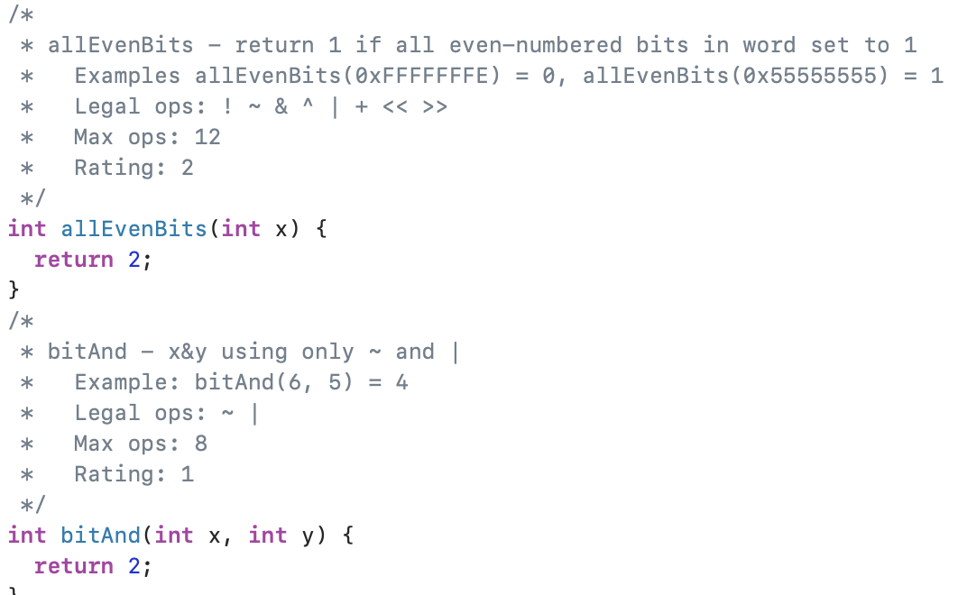
bits.c 내용

Slide 5
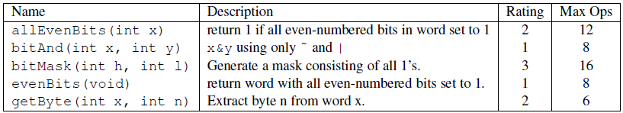
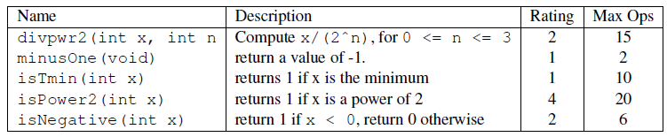
The Puzzles
Bit Manipulations
Two’s Complement Arithmetic

Slide 6
The Puzzles: INTEGER CODING RULES
You are expressly forbidden to:
Use any control constructs such as if, do, while, for, switch, etc.
Define or use any macros.
Define any additional functions in this file.
Call any functions.
Use any other operations, such as &&, ||, -, or ?:
Use any form of casting.
Use any data type other than int. This implies that you cannot use arrays, structs, or unions.
You may assume that your machine:
Uses 2s complement, 32-bit representations of integers.
Performs right shifts arithmetically.
Has unpredictable behavior when shifting an integer by more than the word size.
YOU MUST CAREFULLY READ THE CODING RULES DESCRIBED in bits.c

Slide 7
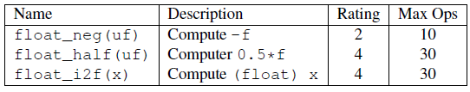
The Puzzles
Floating-Point Operations
You are allowed to use standard control structures (conditionals, loops)
You may not use any floating point data types, operations, or constants

Slide 8
The Puzzles: FLOATING POINT CODING RULES
You are expressly forbidden to:
Define or use any macros.
Define any additional functions in this file.
Call any functions.
Use any form of casting.
Use any data type other than int or unsigned. This means that you cannot use arrays, structs, or unions.
Use any floating point data types, operations, or constants.
YOU MUST CAREFULLY READ THE CODING RULES DESCRIBED in bits.c

Slide 9
The Example Puzzles
/*
* bitXor - x^y using only ~ and &
* Example: bitXor(4, 5) = 1
* Legal ops: ~ &
* Max ops: 14
* Rating: 1
*/
int bitXor(int x, int y) {
return 2;
}

Slide 10
The Example Puzzles
/*
* bitXor - x^y using only ~ and &
* Example: bitXor(4, 5) = 1
* Legal ops: ~ &
* Max ops: 14
* Rating: 1
*/
int bitXor(int x, int y) {
return x^y;
}
$> make
$> ./driver.pl

Slide 11
The Example Puzzles
1. Running './dlc -z' to identify coding rules violations.
/usr/include/stdc-predef.h:1: Warning: Non-includable file <command-line> included from includable file /usr/include/stdc-predef.h.
dlc:bits.c:143:bitXor: Illegal operator (^)
dlc:bits.c:144:bitXor: Zapping function body!
Compilation Successful (1 warning)
2. Running './bddcheck/check.pl -g' to determine correctness score.
3. Running './dlc -Z' to identify operator count violations.
/usr/include/stdc-predef.h:1: Warning: Non-includable file <command-line> included from includable file /usr/include/stdc-predef.h.
dlc:save-bits.c:143:bitXor: Illegal operator (^)
dlc:save-bits.c:144:bitXor: Zapping function body!
Compilation Successful (1 warning)
4. Running './bddcheck/check.pl -g -r 2' to determine performance score.
5. Running './dlc -e' to get operator count of each function.
Correctness Results Perf Results
Points Rating Errors Points Ops Puzzle
0 1 1 0 0 bitXor
0 1 1 0 0 tmin
0 2 1 0 0 isTmax
0 2 1 0 0 allOddBits
0 2 1 0 0 negate
0 3 1 0 0 isAsciiDigit
0 3 1 0 0 conditional
0 3 1 0 0 isLessOrEqual
0 4 1 0 0 logicalNeg
0 4 1 0 0 howManyBits
0 4 1 0 0 float_twice
0 4 1 0 0 float_i2f
0 4 1 0 0 float_f2i
Score = 0/63 [0/37 Corr + 0/26 Perf] (0 total operators)
First puzzle

Slide 12
The Example Puzzles
/*
* bitXor - x^y using only ~ and &
* Example: bitXor(4, 5) = 1
* Legal ops: ~ &
* Max ops: 14
* Rating: 1
*/
int bitXor(int x, int y) {
int x_and_y = x&y;
int x_or_y = ~(~x & ~y);
return x_or_y & ~x_and_y;
}
$> make
$> ./driver.pl

Slide 13
The Example Puzzles
1. Running './dlc -z' to identify coding rules violations.
/usr/include/stdc-predef.h:1: Warning: Non-includable file <command-line> included from includable file /usr/include/stdc-predef.h.
Compilation Successful (1 warning)
2. Running './bddcheck/check.pl -g' to determine correctness score.
3. Running './dlc -Z' to identify operator count violations.
/usr/include/stdc-predef.h:1: Warning: Non-includable file <command-line> included from includable file /usr/include/stdc-predef.h.
Compilation Successful (1 warning)
4. Running './bddcheck/check.pl -g -r 2' to determine performance score.
5. Running './dlc -e' to get operator count of each function.
Correctness Results Perf Results
Points Rating Errors Points Ops Puzzle
1 1 0 2 8 bitXor
0 1 1 0 0 tmin
0 2 1 0 0 isTmax
0 2 1 0 0 allOddBits
0 2 1 0 0 negate
0 3 1 0 0 isAsciiDigit
0 3 1 0 0 conditional
0 3 1 0 0 isLessOrEqual
0 4 1 0 0 logicalNeg
0 4 1 0 0 howManyBits
0 4 1 0 0 float_twice
0 4 1 0 0 float_i2f
0 4 1 0 0 float_f2i
Score = 3/63 [1/37 Corr + 2/26 Perf] (8 total operators)
First puzzle

Slide 14
Helper Programs
The ishow and fshow programs to help you decipher integer and floating point representations respectively.
$> make
$> ./ishow 15213
Hex = 0x00003b6d, Signed = 15213, Unsigned = 15213
$> ./fshow 15213
Floating point value 2.131795354e-41
Bit Representation 0x00003b6d, sign = 0, exponent = 0x00, fraction = 0x003b6d
Denormalized. +0.0018135309 X 2^(-126)

Slide 15
Evaluation
Maximum of 139 points based on the following distribution:
79 Correctness of code
60 Performance of code, based on number of operators used in each function.
Your handin was properly autograded.

Slide 16
Autograding your work
Handy autograding tools
Btest
Checks the functional correctness of the functions in bits.c
dlc
Check for compliance with the coding rules for each puzzle
driver.pl
Compute the correctness and performance points for your solution
$> ./driver.pl

Slide 17
Test and debug your function
Step 1. Test and debug one function at a time using btest
./btest -f bitAnd -1 23 -2 0xabcd
Step 2. Use btest -f to check the correctness of your function against a large number of different input values:
./btest -f isLess
Step 3. Use dlc to check that you’ve conformed to the coding rules
./dlc bits.c
Step 4. Repeat Steps 1–3 for each function. At any point in time, you can compute the total number of correctness and performance points you’ve earned by running the driver program:
./driver.pl

Slide 18
Submission
Due to 4/19 (수) 자정
딜레이 감점 있음(최대 1일 20% 감점: 잠정적임)
학번_bits.c, 학번_selfgrade.jpg 를 PLATO에 제출
학번_selfgrade.jpg 는 최종 driver.pl 출력 캡처 이미지
Please Read the Writup.
datalab-writeup.pdf

Slide 19
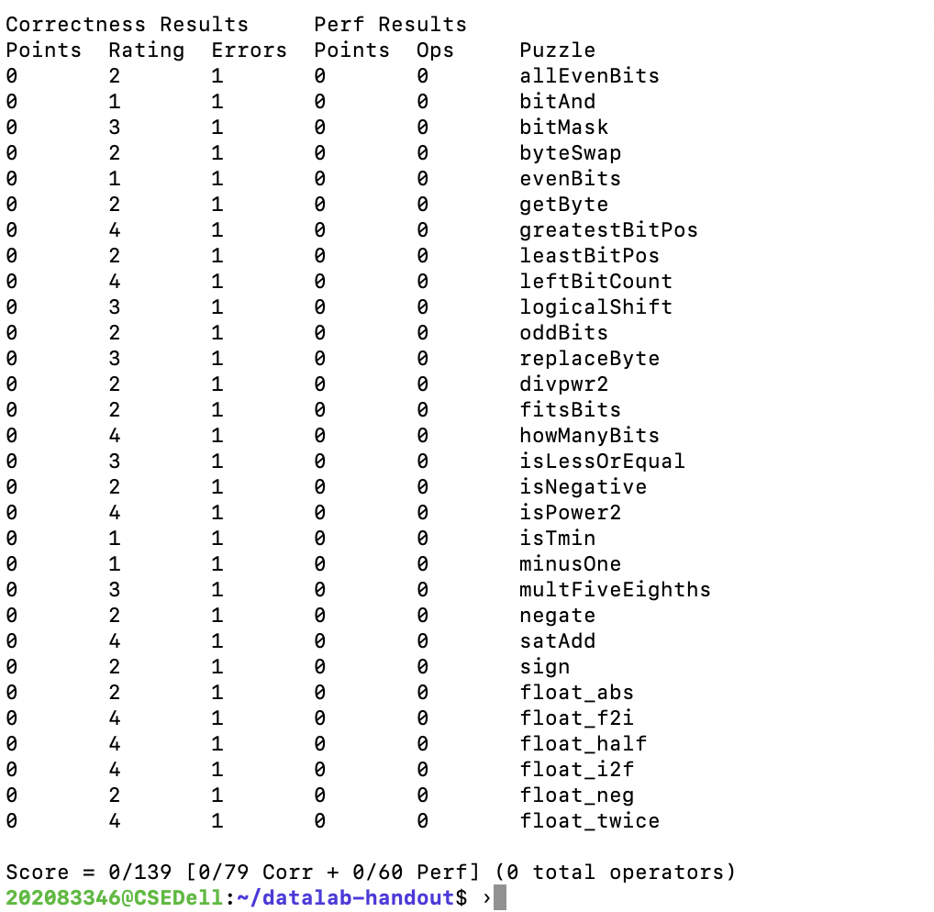
학번_selfgrade.jpg

